Slide 1


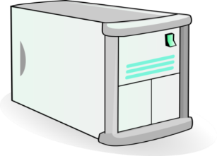


MDM Architecture (existing)
intranet
LDAP
Opsi
2
Web MDM
iNews lt6
Ubuntu
172.17.20.26
4CPU, 4GB Memory, 30GB HDD
API service
API Call
DB MDM
iNews lt6
Ubuntu
172.17.20.64
8 CPU, 8GB Memory, 150 GB HDD
DWHs
Opsi
1
Backend MDM
Pentaho Data Integration
DB Backup
Power BI Data Gateway
iNews lt6
Windows Server
mnchdwh01
172.17.20.217
10CPU, 20GB Momory, 150 GB HDD
DB Staging
Host to Host DB Conn
DWHs
BU / Product
MDM

Slide 2
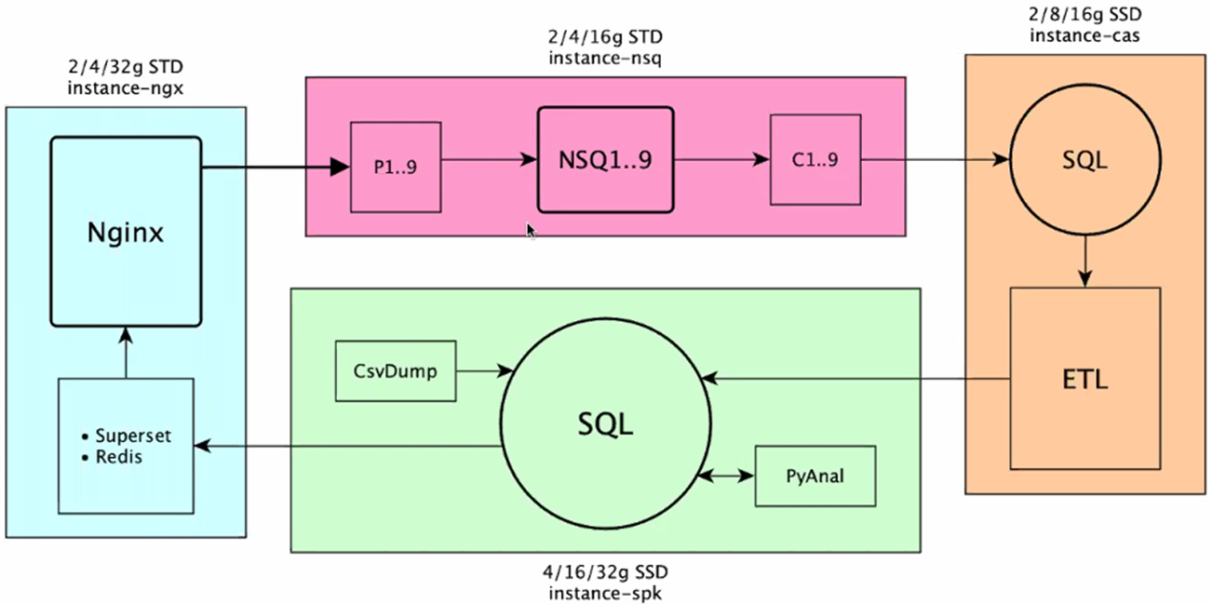
MNC Analytic Architecture (Cloud)

Slide 3
MDM & MNC Analytic Architecture (propose)
Intranet (User)
LDAP
Web MDM
Ubuntu
Internet CSV file V+, R+, MPI
DB MDM
Ubuntu
DB Staging BU
Ubuntu
API service
API Call
DWHs
Connection Gateway
Ubuntu
Backend MDM
Pentaho Data Integration
DB Backup
Power BI Data Gateway
Ubuntu / Windows Server
Host to Host DB Conn
DWHs
DB Staging
DB & File Server
BU / Product
Intranet (User)
Analytics

Slide 4
MDM & MNC Analytic Propose

